Slide 1
Matchify
Matt Jordan, Blake dobbins, xuanwei li, Jeron duhart-rodriguez

Slide 2


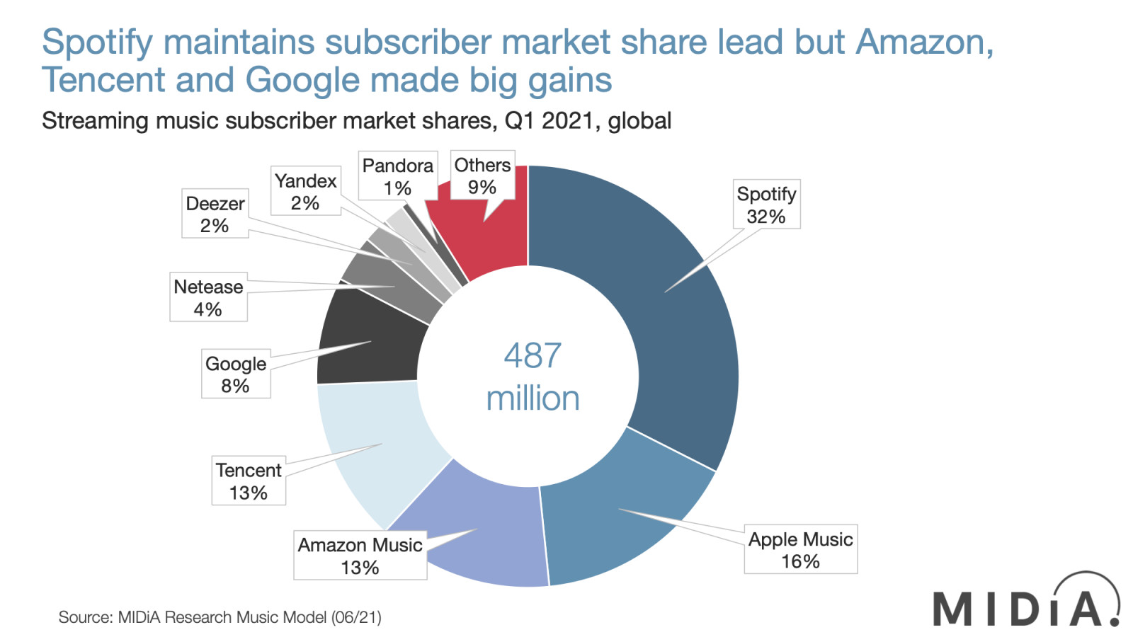


Slide 3
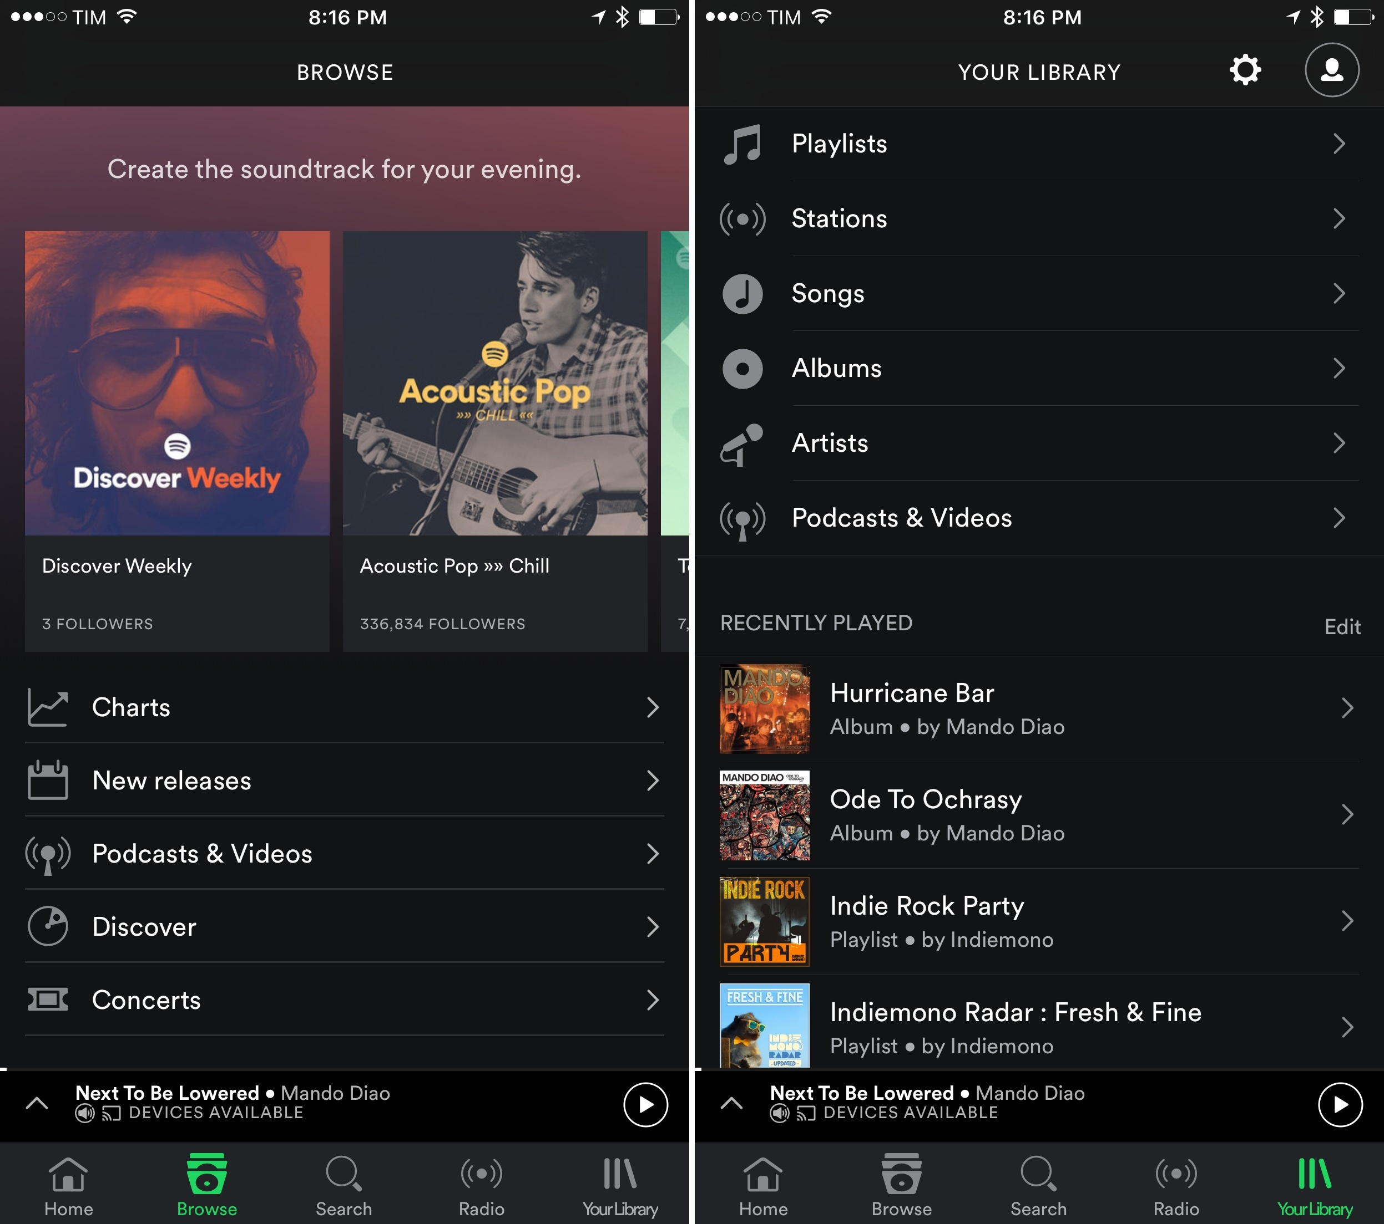
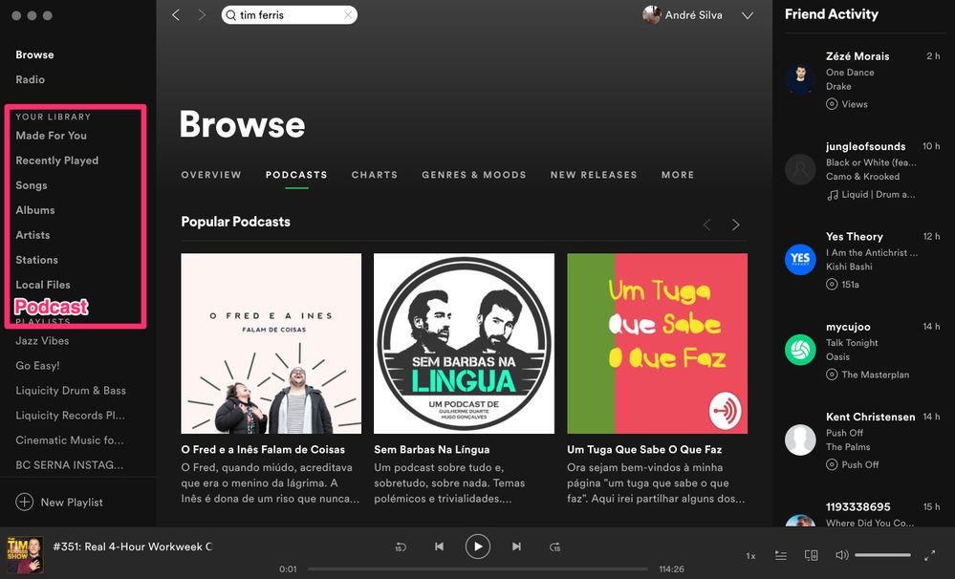

Slide 4
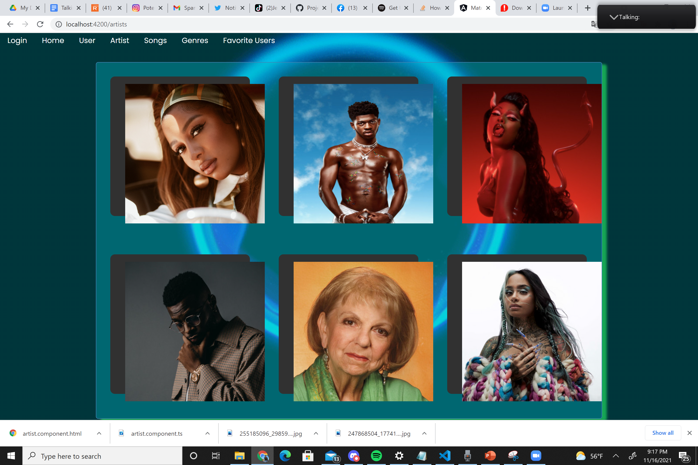
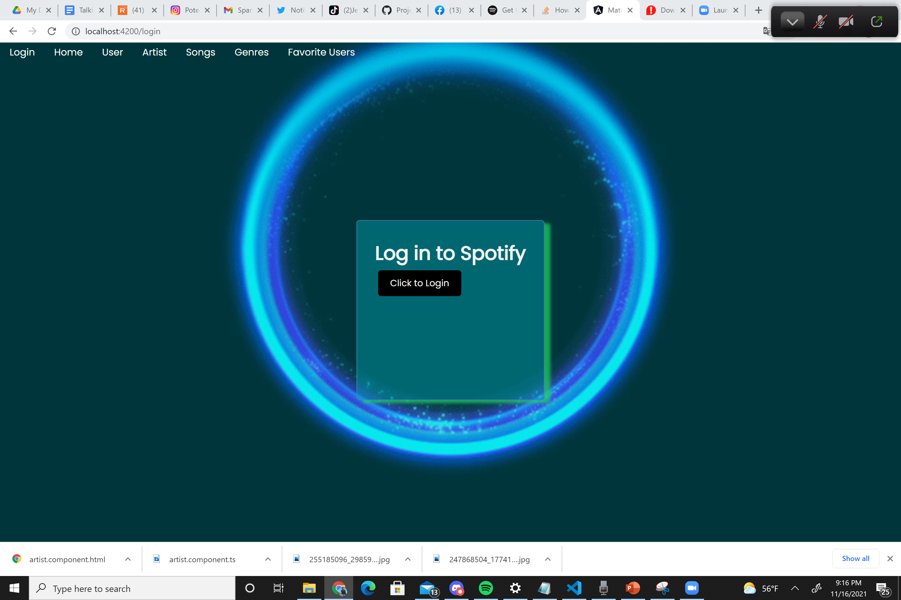
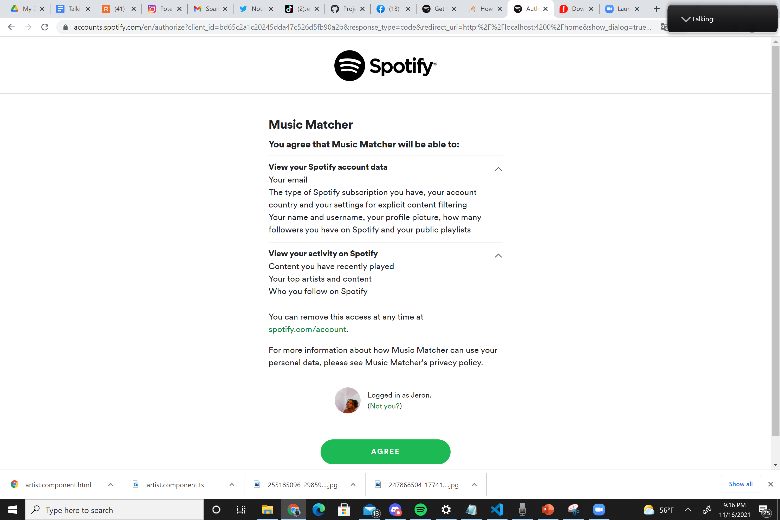
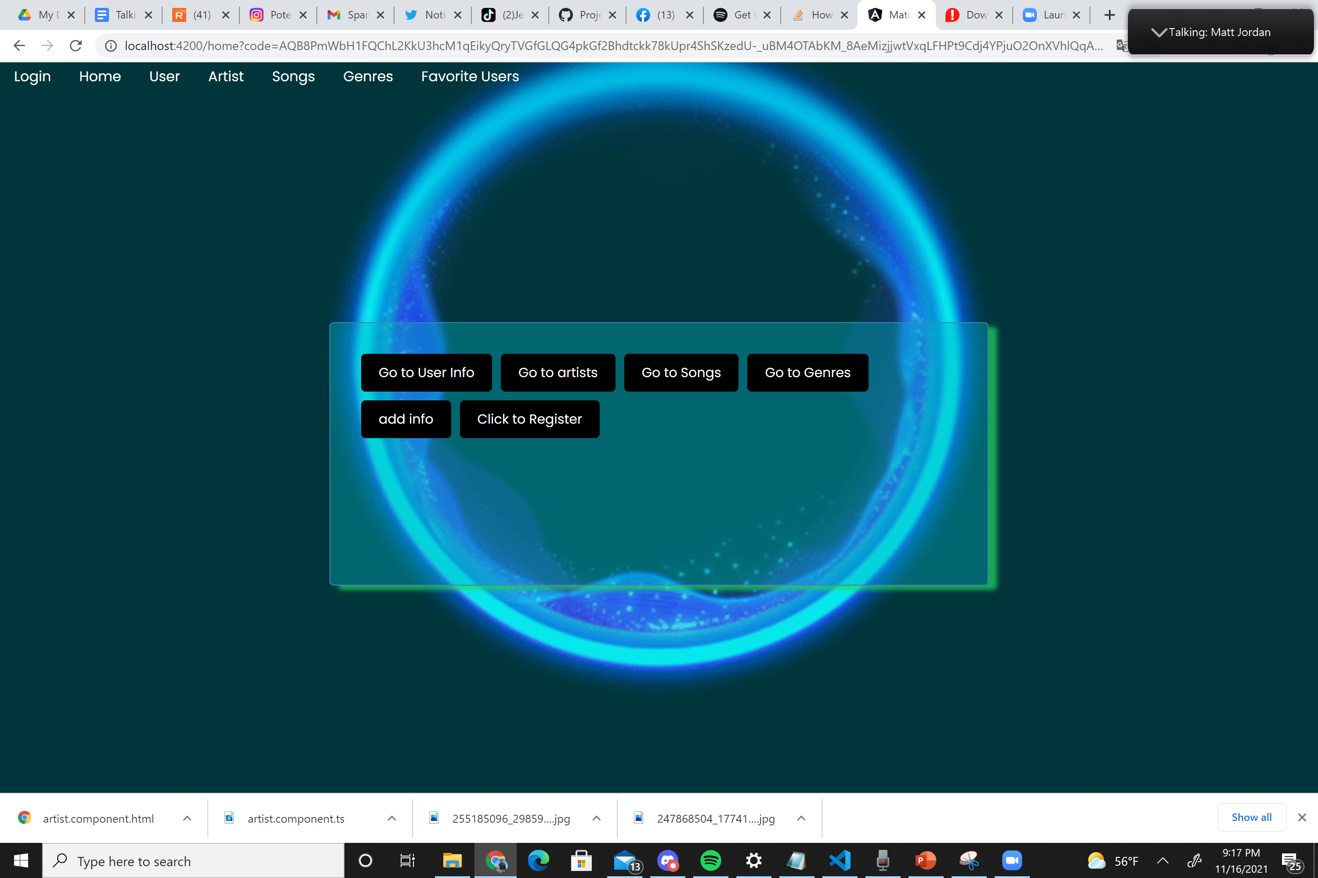
How to use it!
Begin at Login Page
Redirected to access grant page
Then given a list of different views to display
Shows various top fields based on account and selection

Slide 5








Slide 6
Demo

